Slide 1
THE TRANSMISSION CONTROL PROTOCOL TCP & Spread Spectrum

Slide 2
TCP
The Network VS Internet
Topology, bandwidth, delays, packets size , and different parameters
TCP Entity
A library function or a user program
Accepts user data streams from local processes , breaks them into the pieces not larger than 64K , and sends them as a separate IP data gram. and vice versa
IP layer provides no guarantee about the reliable delivery of data but its TCP entity.

Slide 3
The TCP Service Model
Socket
Port number and IP address
Port number
Reserved ports
TCP PORT MULTIP 01
FTP 21
TELNET 23
SMTP 25
TFTP 69
HTTP 80
NNTP 119
DNS 53
All TCP Connections are full duplex

Slide 4
The TCP Protocol
TCP Segment
The TCP Segment Length
MTU and its different cases
Sliding window protocol
TCP retransmission

Slide 5
The TCP Header
Max Packet size
Packet without data
Window size
Socket Vs Port

Slide 6
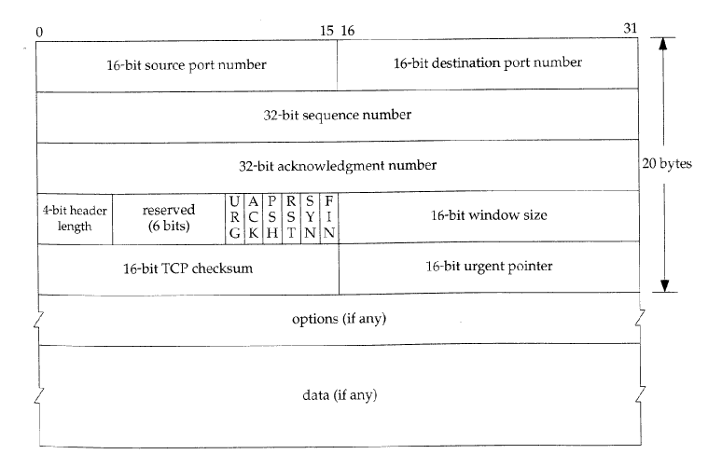
The TCP Header

Slide 7
TCP Connection Establishment
Connect Primitive
Connection rejection
Connection establishment
Two connection between same hosts
Connection release
FIN from both sides at the same time
FIN not acknowledged

Slide 8
TCP connection Management and Transmission Policy
Buffer
Buffer filled
Urgent messaging (window prob)
Low utilization of the band width
Nagle’s Algorithm
Delayed Acknowledgement, streamings.
Silly window syndrome
Clark’s Algorithm
Out of order segments

Slide 9
TCP Congestion Control and Timer Management
TCP slows down data rate
Law of conservation of Packets
Time outs and packet lost
Buffer window
Congestion Window
Slow start
Retransmission timer
Karen’s Algorithm

Slide 10
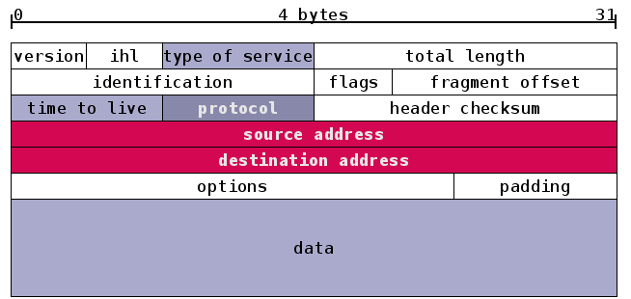
IP Header

Slide 11
Electromagnetic Spectrum

